Slide 1
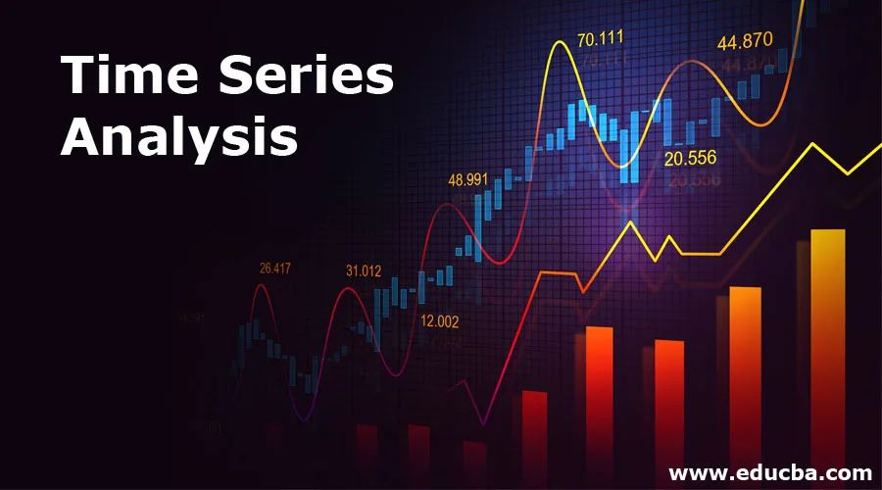
Robust yield prediction of various farm processing units
-A Capstone project
V.Venu gopal reddy | batch – 111 | Emp id : 4781

Slide 2
PROBLEM DESCRIPTION
A new fast food chain is seeing rapid expansion over the past couple of years.
They are now trying to optimize their supply chain to ensure that there are no shortages of ingredients.
For this, they’ve tasked our data science team to come up with a model that could predict the output of each food processing farm over the next few years.
These predictions could further increase the efficiency of their current supply chain management systems.
fast food processing company has a certain amount of farms with farm areas and ids according to the farms in this we have to predict the yield for each farm during the given timestamps.
V.Venu gopal reddy | batch – 111 | Emp id : 4781

Slide 3



WHAT?
Food Processing plants want to increase the Company Expansion
WHEN?
To meet the demand of year 2017
HOW?
Creating a Machine Learning model for
Time-Series to predict the yeild
V.Venu gopal reddy | batch – 111 | Emp id : 4781

Slide 4
DATA
train_data.csv
date
farm_id
ingredient_type
yield
Farm_data.csv
train_weather.csv
farm_id
founding_year
num_processing_plants
farm_area
farming_company
deidentified_location
temp_obs
wind_directiondew_temp
pressure_sea_level
wind_speed
  date
  farm_id
  ingredient_type
test_data.csv
  farm_id
  founding_year
  num_processing_plants
  farm_area
  farming_company
  deidentified_location
farm_data.csv
  temp_obs
  wind_directiondew_temp
  pressure_sea_level
  wind_speed
test_weather.csv
V.Venu gopal reddy | batch – 111 | Emp id : 4781

Slide 5
YIELD DATA
ING_W
ING_X
ING_Y
ING_Z
1398
Unique
Farm_id’s
496
Unique
Farm_id’s
324
Unique
Farm_id’s
145
Unique
Farm_id’s
Here in the data I have to predict the yields according to the ingredient
so divided the data set according to the ingredient
V.Venu gopal reddy | batch – 111 | Emp id : 4781

Slide 6
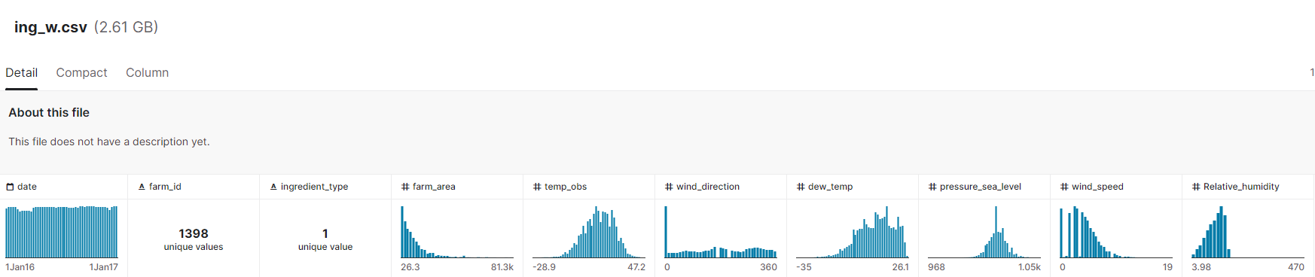
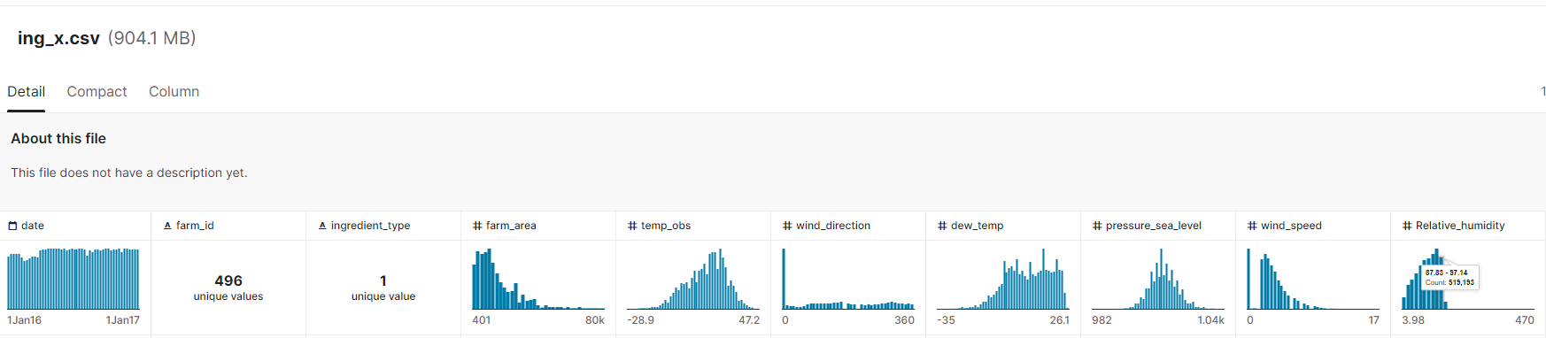
BASIC ANALYSIS OF DATA
V.Venu gopal reddy | batch – 111 | Emp id : 4781

Slide 7
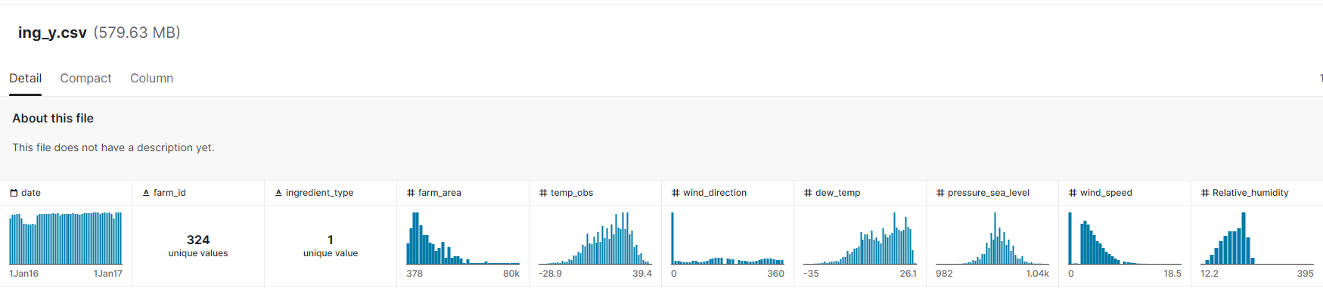
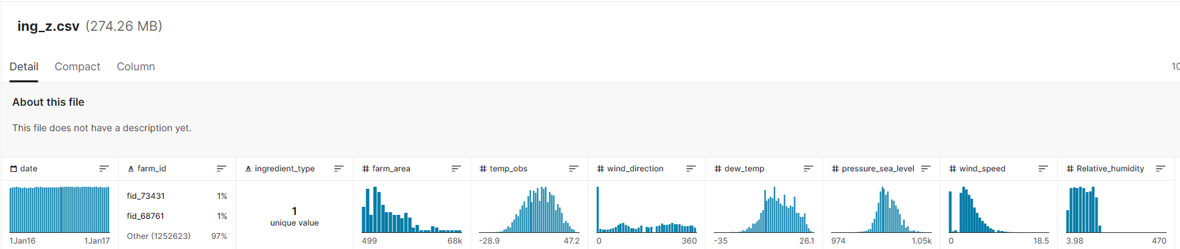
BASIC ANALYSIS OF DATA
V.Venu gopal reddy | batch – 111 | Emp id : 4781

Slide 8

CHALLENGES FACED :
Handling with Bigdata
Handling with Multivariant time Series data
Handling with Pannal data in time series analysis
Handling Missing Values
V.Venu gopal reddy | batch – 111 | Emp id : 4781

Slide 9
MODEL I USED !
Moving Average: The Moving Average (MA) function computes the average of a set of input values over a specified number of periods.
The smaller the number of periods, the faster the moving average responds to changes in the input values.
The mathematical expression being calculated is as follows:
Mat = (Yt + Yt-1 + Yt-2 + ... + Yt-N+1) / N
Where N is the number of time periods and Y is the value.
V.Venu gopal reddy | batch – 111 | Emp id : 4781

Slide 10
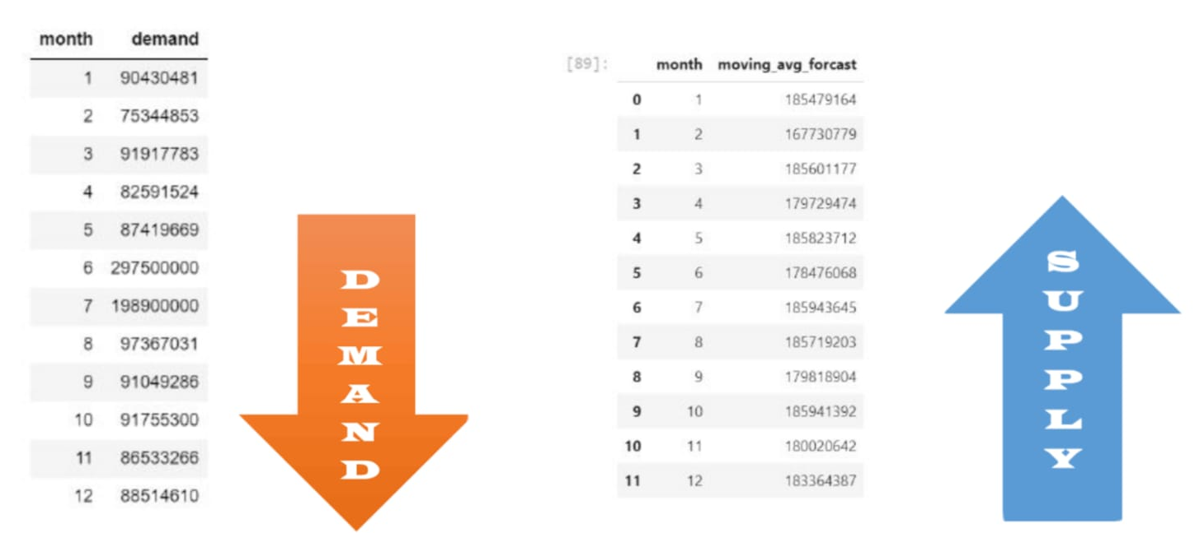
FINAL ANALYSIS OF DATA – INGREDIENT W
After our predictions the demand is low and the production is high here
but we can store the ingredient for 8 months so that there can be no shortage
if we are using moving average model here
V.Venu gopal reddy | batch – 111 | Emp id : 4781

Slide 11
V.Venu gopal reddy | batch – 111 | Emp id : 4781

Slide 12
Conclusion
About this project
Considering the data provided on 2016, We Built a model following all the conditions like wind_direction, farm_area, temp_obs, wind_direction, dew_temp, pressure_sea_level, wind_speed, Relative_humidity. This model helps you to predict your yields by entering the values which we have used to built in model
We can plan how to manage the yield to meet the demand and expand the farm_processing company In upcoming years.
As we know how the ingredients are stored, so by knowing the yield before the demand we can preserve then very carefully to meet the future needs.
Note: We have to perform deployment for gaining that in simple clicks.
V.Venu gopal reddy | batch – 111 | Emp id : 4781

Slide 13
Learning Outcomes
After this project
Dealing with Time-Series data.
Knowing all the elements required for time series data.
How to handle the missing values according to the attribute.
How to use stack over flow efficiently.
Converting the data in to parts to work on my machine.
How EDA helps me to find the relationship between attributes and target attribute.
Using Pandas and NumPy efficiently.
Presentation skills.
V.Venu gopal reddy | batch – 111 | Emp id : 4781

Slide 14
THANKYOU
V.Venu gopal reddy | batch – 111 | Emp id : 4781

